Slide 1

WQD 7003 Data Analytics
CHAPTER 1 – INTRODUCTION TO DATA ANALYTICS
Saw Shier Nee, Hema Subramaniam & Aznul Qalid Md Sabri
sawsn@um.edu.my, hema@um.edu.my, aznulqalid@um.edu.my
Dept. of AI, Fac. of Computer Science and IT, University of Malaya
Dept. of SE, Fac. of Computer Science and IT, Universiti Malaya

Slide 2

Outline
Key functions of data scientist
General aptitude of data scientist
Data analytics
Descriptive
Diagnostic
Predictive
Prescriptive
Data vs Information

Slide 3
Learning Outcomes
At the end of this lecture, student will be able to:
To explain the data analytic concept

Slide 4
Data vs Information
Data: numerical or textual facts and figures that are collected through some type of measurement process
Information: result of analyzing data; that is, extracting meaning from data to support evaluation and decision making

Slide 5
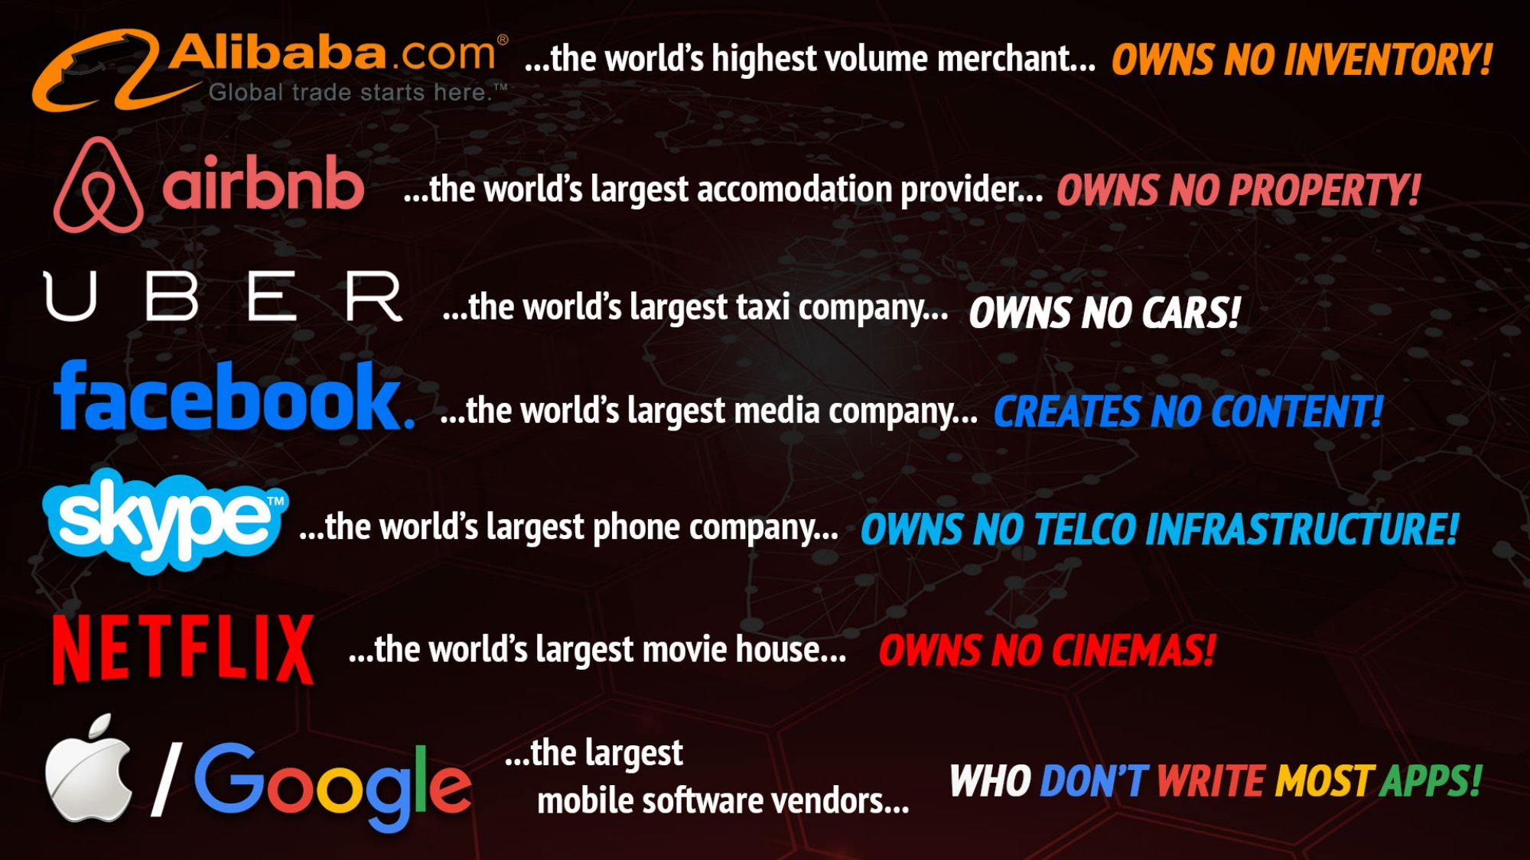
Opening case

Slide 6
Data for Data Analytics
Data set: a collection of data.
Examples: Marketing survey responses, a table of historical stock prices, and a collection of measurements of dimensions of a manufactured item
Database: a collection of related files containing records on people, places or things.
A database file is usually organized in a two-dimensional table, where the columns corresponds to the each individual element of data (called fields, or attributes), and the rows represent records of related data elements.
Data warehouse: a collection of databases used for reporting and data analysis.
Data mart: A departmental data warehouse that stores only relevant data

Slide 7

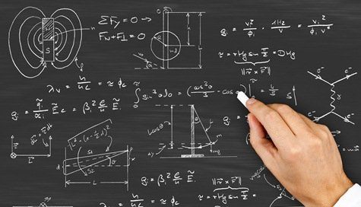

What do people think Data Scientist can do?
Complex mathematics in multidimensional spaces
Lots of data
Magical results

Slide 8
In Reality…..
Collect data
Create model
Deploy fleshed out model
Clean and organize data
Use machines to flesh out the model from data

Slide 9
Key functions of data scientist
Understanding the business problem
Data Mining and Analysis Design
Descriptive and Predictive Analytics
Devising Business Strategies from the insights

Slide 10
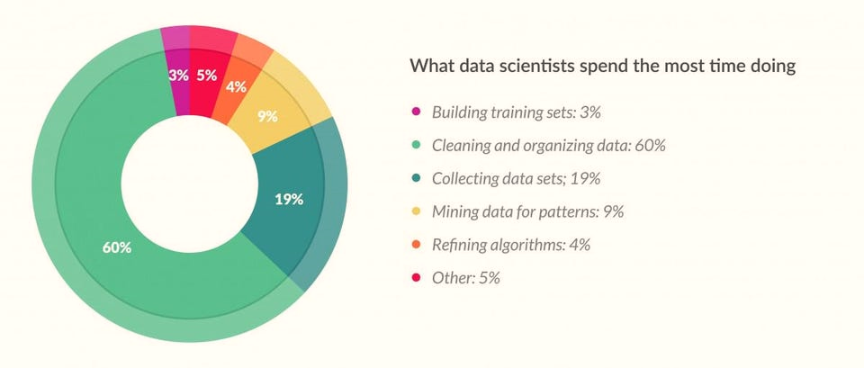
Key functions of data scientist
Cleaning and organizing data:
60%
http://www.forbes.com/sites/gilpress/2016/03/23/data-preparation-most-time-consuming-least-enjoyable-data-science-task-survey-says/#f37c7f758459

Slide 11
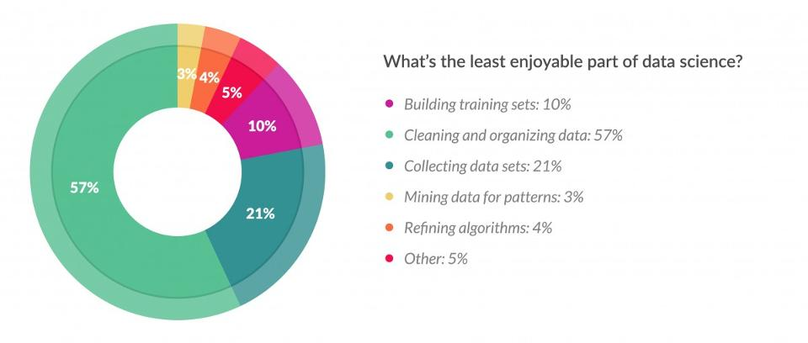
Key functions of data scientist
Cleaning and organizing data:
57%
http://www.forbes.com/sites/gilpress/2016/03/23/data-preparation-most-time-consuming-least-enjoyable-data-science-task-survey-says/#f37c7f758459

Slide 12
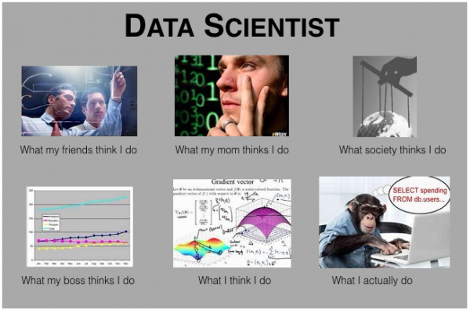
Key functions of data scientist

Slide 13

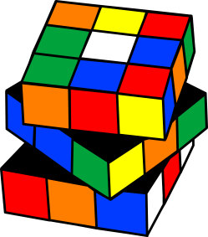

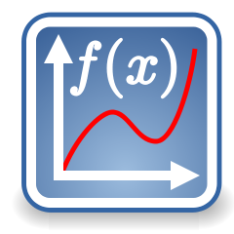


General aptitude of data scientist
Common sense
Curious mind
Clear and simplify thought
Love to solve puzzles
Maths & Stats
Good listening, writing and communication skills (visualizations)
Business sense
Data Scientist

Slide 14
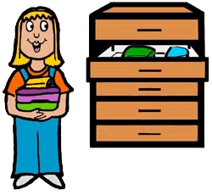

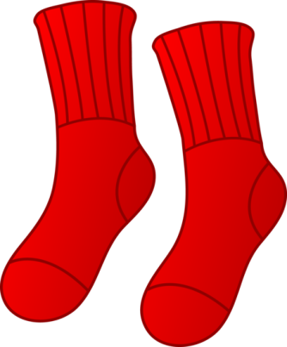

Try to solve this
TRY 1
I have 4 red, 18 black and 8 brown socks in my sock drawer. If it is completely dark and I cannot see the colour of the socks that I am picking, how many socks do I need to take from the drawer to be sure that I have at least one pair of socks that are the same colour?
4

Slide 15
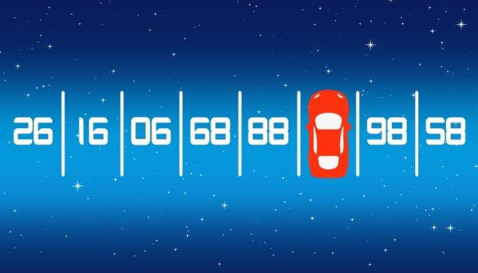
Try to solve this
What is the hidden number under the car?
TRY 2
87

Slide 16
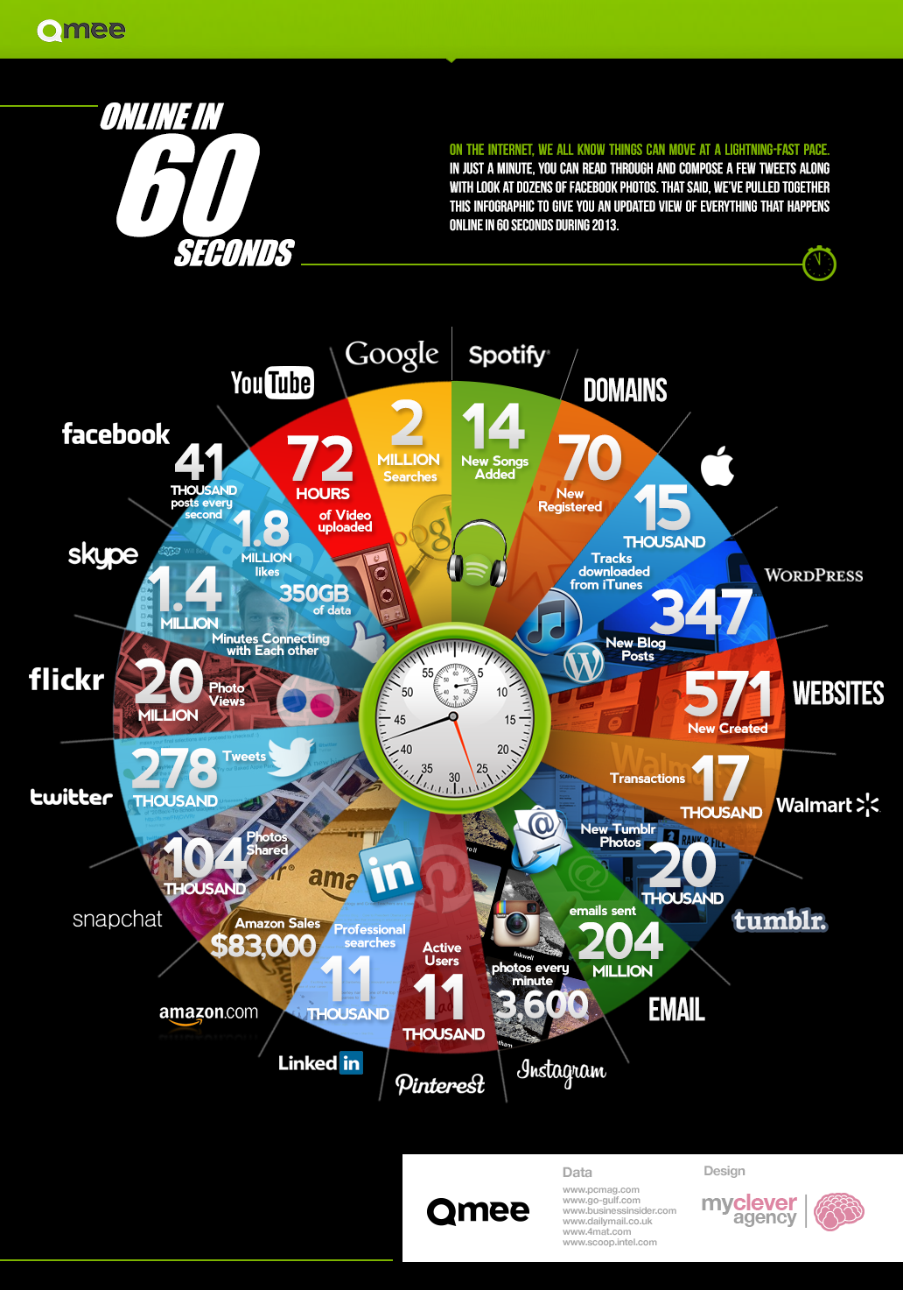
Data Analytics
What happens in 60 seconds
DATA SCIENCE

Slide 17
Analytics vs Analysis
Analysis refers to the process of separating a whole problem into its parts so that the parts can be critically examined at the granular level.
Analytics is a variety of methods, technologies and associated tools for creating new knowledge/insight to solve complex problems and make better and faster decisions
Delen(2015)

Slide 18
What Can Be Learned From Data?
Data analytics is an emerging technique that dives into a data set without prior set of hypotheses
The data derive meaningful trends or intriguing findings that were not previously seen or empirically validated (Leventhal, 2010).
Data analytics enables quick decisions or help change policies due to trends observed

Slide 19
Data Analytics
Accumulation of raw data captured from various sources (i.e. discussion boards, emails, exam logs, chat logs in e-learning systems) can be used to identify fruitful patterns and relationships
(Bose, 2009)
Exploratory Visualization
relationships that are perhaps unknown or at least less formally formulated
Confirmatory Visualization
theory-driven

Slide 20
Type of Data Analytics
Prescriptive
What do I need to do?
-Recommended actions and strategies
-Applying advanced analytical techniques
Predictive
What’s likely to happen?
-business strategies consistent over-time
-current/historical pattern predict the future
-Decision Automated
Diagnostic
Why is it happening?
-root-cause
-isolate confounding information
Descriptive
What’s happening?
-comprehensive and live data

Slide 21
Types of Data Analytics
Prescriptive
Optimization
Predictive
foresight
Value
Diagnostic
insight
Descriptive
Information
Hindsight
Difficulty

Slide 22
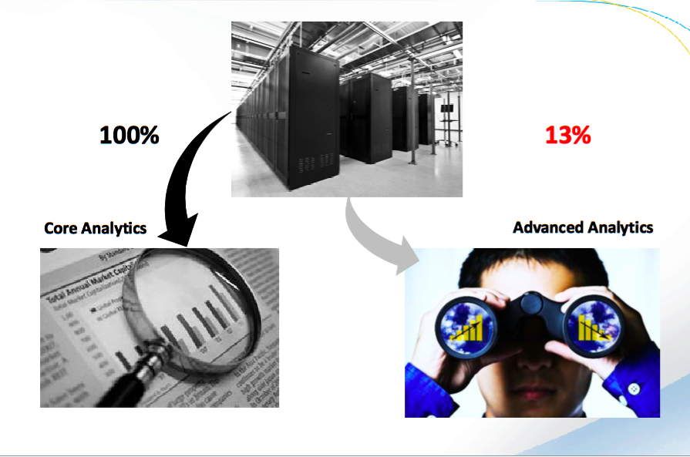
100%
13%
It is not about more data, it is about deeper look
Core analytics
Advanced analytics

Slide 23
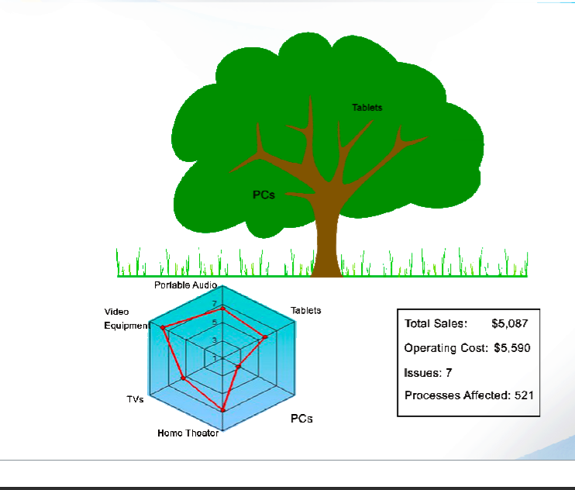
Descriptive – What Happened?

Slide 24
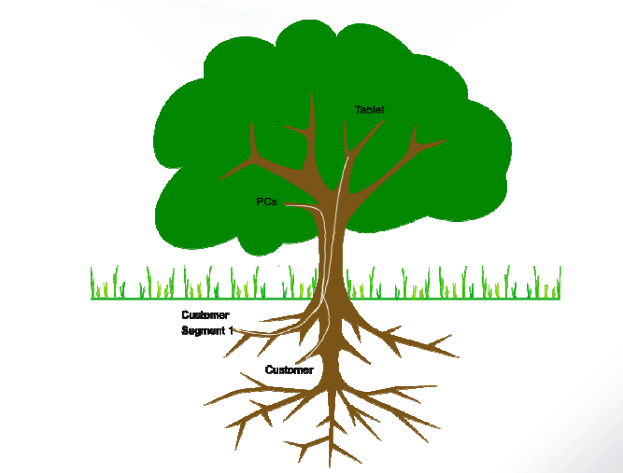
Diagnostic– Why is it happening?

Slide 25
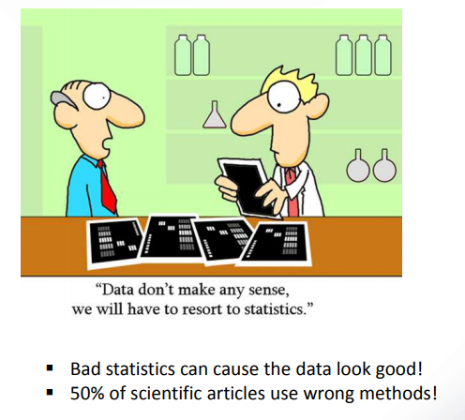
Predictive– What’s likely to happend

Slide 26
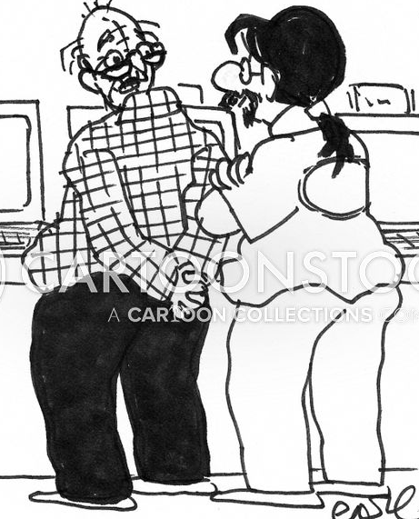
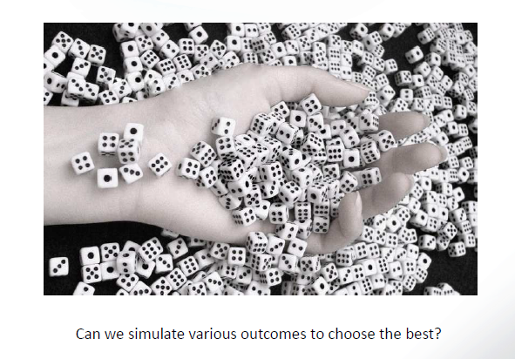
Prescriptive– What do I need to do?

Slide 27
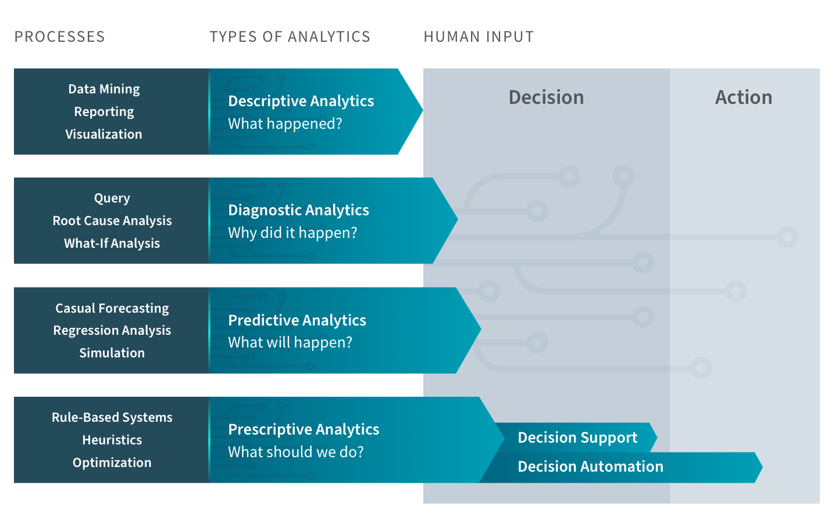

Slide 28
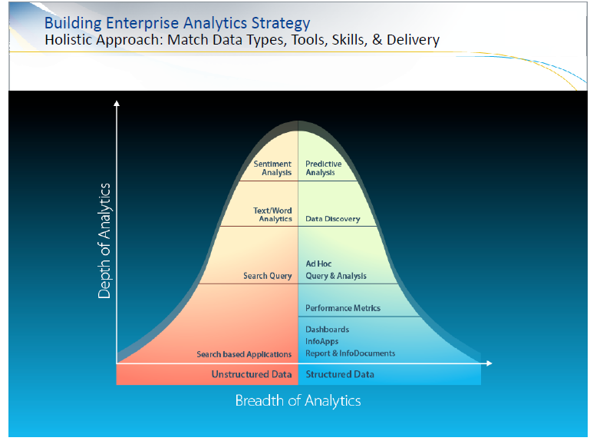

Slide 29
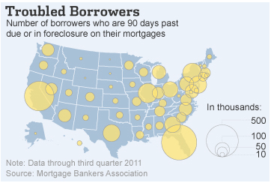
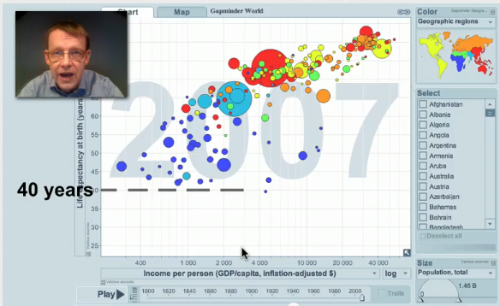
Data Analytics Applications
Source: The Wall Street Journal

Slide 30

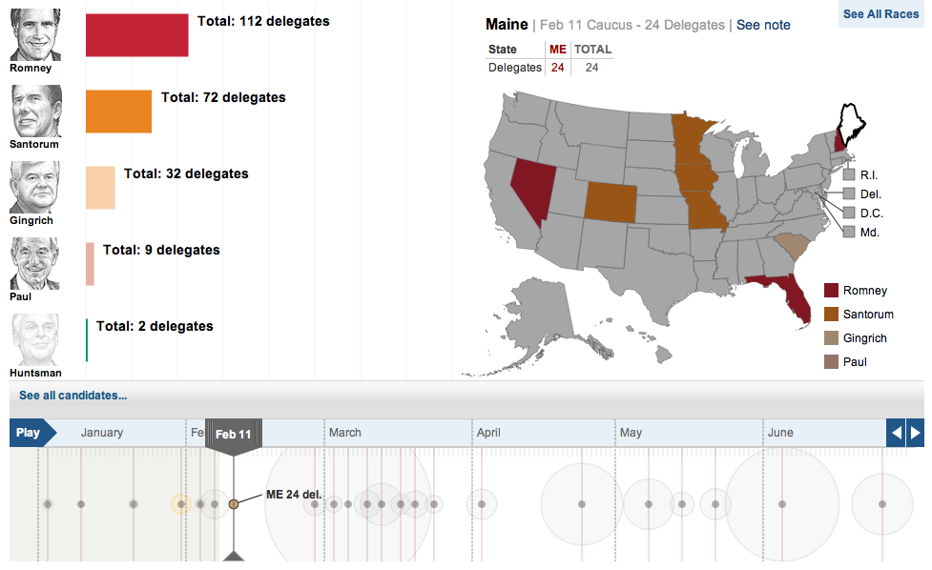
Source: The Wall Street Journal

Slide 31
Related Videos / Reference
Gartner report on data-driven decision making is critical to create business value
Refer to this link: https://www.gartner.com/en/information-technology/insights/data-analytics
Youtube video on What Is Data Analytics? - An Introduction (Full Guide)
https://www.youtube.com/watch?v=yZvFH7B6gKI

